Slide 1
Chap 4: Fuzzy Logic
FSKKP, UMP
BCS2313: Artificial Intelligence Techniques

Slide 2
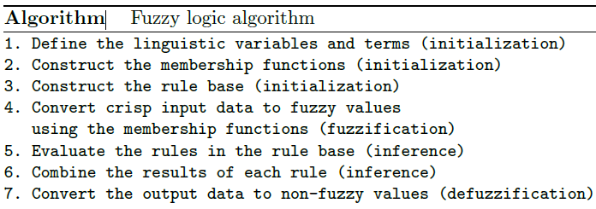
Fuzzy Logic Algorithm

Slide 3
Step 1: Linguistic Functions & Terms
Temp:
{Freezing(0-30), Cool(30-60), Warm(60-80), Hot(80-100)}
Cover:
{Sunny(0-30), Partly Cloudy(30-70), Overcast(80-100)}
Speed:
{Slow(0-50), Fast(50-100)}

Slide 4
Step 2: Construct Membership Functions

Slide 5
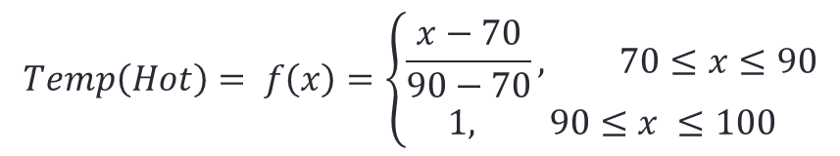
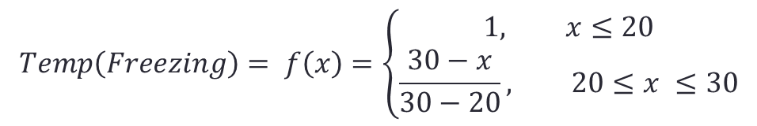
Step 2: Construct Membership Functions
$$Temp\left(Freezing\right)= f\left(x\right)=\left\{\begin{aligned}1, x≤20 \\ &\frac{30−x}{30−20}, 20≤x ≤30\end{aligned}\right.$$
$$Temp\left(Hot\right)= f\left(x\right)=\left\{\begin{aligned}\frac{x−70}{90−70}, 70≤x≤90 \\ &1, 90≤x ≤100\end{aligned}\right.$$

Slide 6
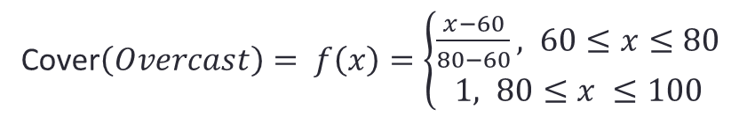
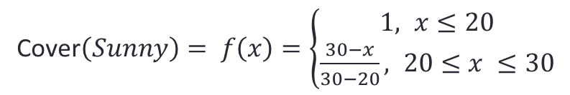
Step 2: Construct Membership Functions
Cover$\left(Sunny\right)= f\left(x\right)=\left\{\begin{aligned}1, x≤20 \\ &\frac{30−x}{30−20}, 20≤x ≤30\end{aligned}\right.$
Cover$\left(Overcast\right)= f\left(x\right)=\left\{\begin{aligned}\frac{x−60}{80−60}, 60≤x≤80 \\ &1, 80≤x ≤100\end{aligned}\right.$

Slide 7
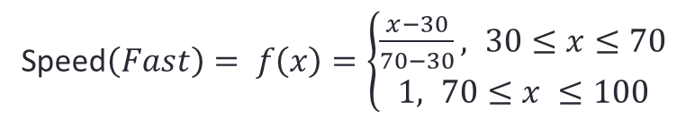
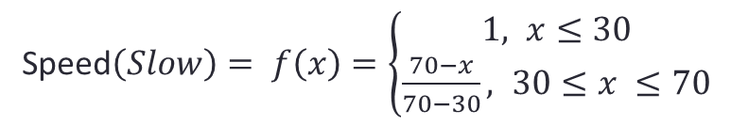
Step 2: Construct Membership Functions
Speed$\left(Slow\right)= f\left(x\right)=\left\{\begin{aligned}1, x≤30 \\ &\frac{70−x}{70−30}, 30≤x ≤70\end{aligned}\right.$
Speed$\left(Fast\right)= f\left(x\right)=\left\{\begin{aligned}\frac{x−30}{70−30}, 30≤x≤70 \\ &1, 70≤x ≤100\end{aligned}\right.$

Slide 8
Step 3: Construct Rules
For our problem the rules are given as below:-
If it's Sunny and Cool, drive Fast
If it's Sunny and Hot, drive Fast
If it's Cloudy and Warm, drive Slow
If it's Cloudy and Cool, drive Slow

Slide 9
Step 3: Construct Rules
Cover(Sunny) ˄ Temp(Cool) => Speed (Fast)
Cover(Sunny) ˄ Temp(Hot) => Speed (Fast)
Cover(Cloudy) ˄ Temp(Warm) => Speed (Slow)
Cover(Cloudy) ˄ Temp(Cool) => Speed (Slow)

Slide 10
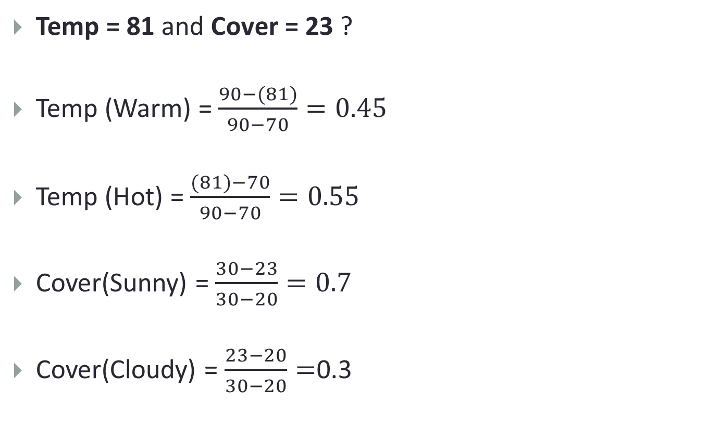
Step 4: Fuzzification (1st FL Step)
Temp = 81 and Cover = 23 ?
Temp (Warm) = $\frac{90−(81)}{90−70}=0.45$
Temp (Hot) = $\frac{(81)−70}{90−70}=0.55$
Cover(Sunny) = $\frac{30−23}{30−20}=0.7$
Cover(Cloudy) = $\frac{23−20}{30−20}=$0.3

Slide 11
Step 5: Rules Evaluation (2nd FL Step)
Temp(Warm)/Temp (Hot) & Cover(Sunny)/Cover(Cloudy)
Cover(Sunny) ˄ Temp(Cool) => Speed (Fast)
Cover(Sunny) ˄ Temp(Hot) => Speed (Fast)
Cover(Cloudy) ˄ Temp(Warm) => Speed (Slow)
Cover(Cloudy) ˄ Temp(Cool) => Speed (Slow)

Slide 12
Step 6: Inference (3rd FL Step)
Cover(Sunny) ˄ Temp(Hot) => Speed (Fast)
0.7 ˄ 0.55 => 0.55 (AND)
(AND is Minimum btw 2 sets)
(OR is Maximum btw 2 sets)
Cover(Cloudy) ˄ Temp(Warm) => Speed (Slow)
0.3 ˄ 0.45 => 0.3
Rules aggregation
Speed(Fast) = 0.55 & Speed (Slow)=0.3

Slide 13

Step 7: Defuzzification (4th FL Step)
COG =$\frac{\left(0+10+20+30+40+50+60\right)∗0.45+\left(70+80+90+100\right)∗0.7}{0.45+0.45+0.45+0.45+0.45+0.45+0.45+0.7+0.7+0.7+0.7}$
COG=55.88
$∴$ Temp = 81 and Cover = 23, Speed = 55.88

